Slide 1
Presentation

Slide 2
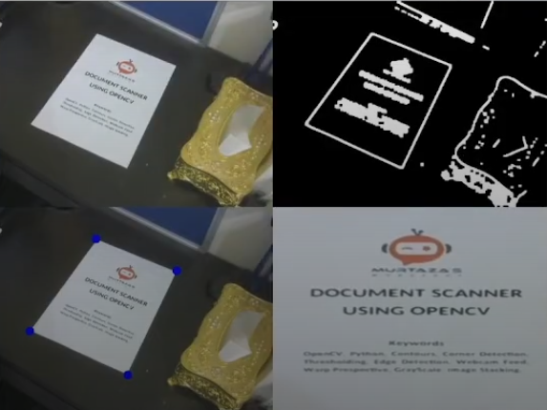
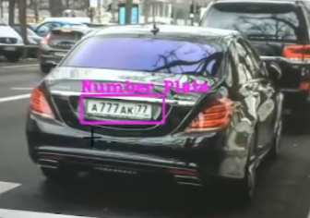
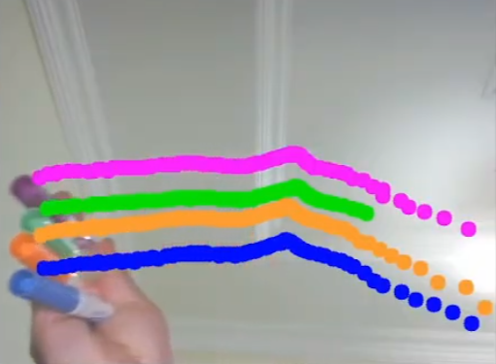
Task assignment
Document scanner: Dani
Number plate detected: Marci
Virtual paint: Matyi

Slide 3
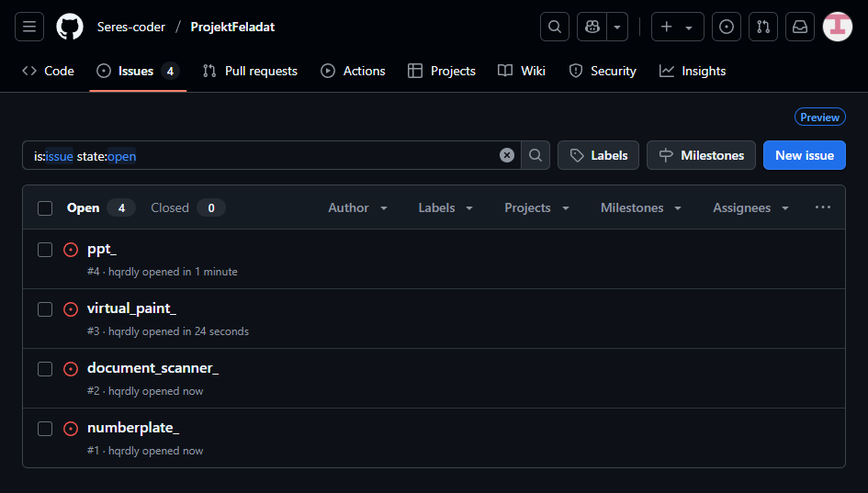
Project managing tools
Github

Slide 4

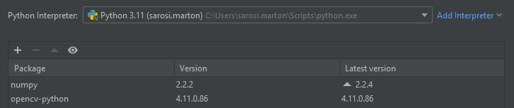
Programozás eszközei
OpenCV: computer vision library
Numpy: NumPy is a Python library used for working with arrays
Haarcascade: a machine learning-based object detection method used in computer vision

Slide 5
Number plate detected
python interpreter
import cv2 library
import numpy
sizing display
import camera vision
plate detection
crop and save plate as .jpg

Slide 6
Virtual paint
python interpreter
import cv2
import numpy
sizing display
import camera vision
detecting and separating colors
drawing points at the tip of the pen with the matching color

Slide 7
Document scanner
python interpreter
import cv2
import numpy
sizing display into 2 section
separate document
finding the corners
blurring the picture
cropping out the document and rotate
displaying the final crop

